Slide 1
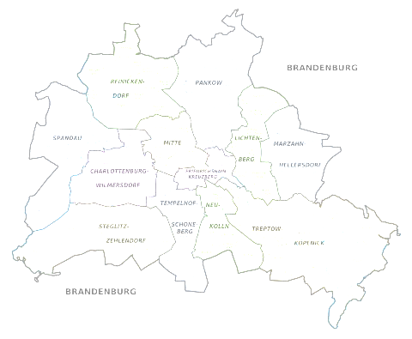
The Battle of Neighborhoods in Berlin
Source: wikimedia Berlin_Subdivisions.svg

Slide 2
Objective
Berlin - the attractive metropole -> people move to Berlin
Need to analyze systematically the environment of potential locations
Identify and understand similarities and dissimilarities of neighborhoods
Select potential locations indexed by zipcode

Slide 3
Steps
Index geographical information of Berlins neighborhoods by zipcodes
Collect venues using Foursquare API and form clusters based on venue categories for each zipcode
Use dendrogram and hierarchical clustering in order to cluster zipcodes
Analyze similarities and dissimilarities of clusters
Analyze socio-demographic features
Explore top rated venues using Yelp API

Slide 4
Python libraries
Libraries | Description
Pandas, Numpy | Libraries for data storage, manipulation and array computing
Scipy | Library for dendrogram and hierarchical cluster analysis
Geopy | Library to retrieve locational data
Matplotlib, Folium | Libraries for representing numeric and locational data
Requests, Urllib | Libraries to retrieve data and handle http exchange with the Foursquare API and Yelp API

Slide 5
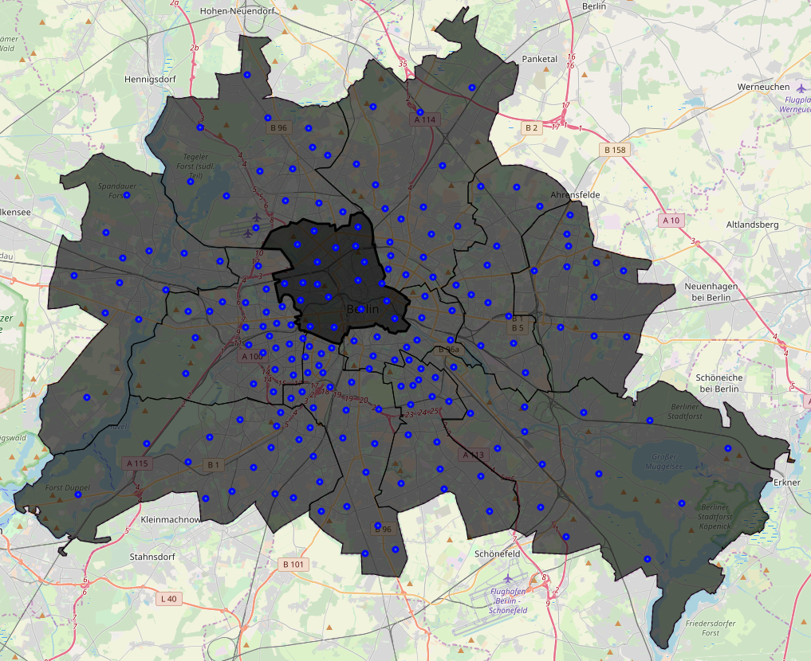
Points of measurement and boroughs

Slide 6
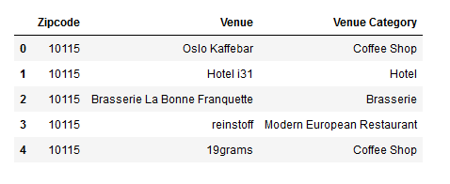
Venues at zipcodes
Dataset consists of
13368 venues
in 366 venue categories
examples:

Slide 7
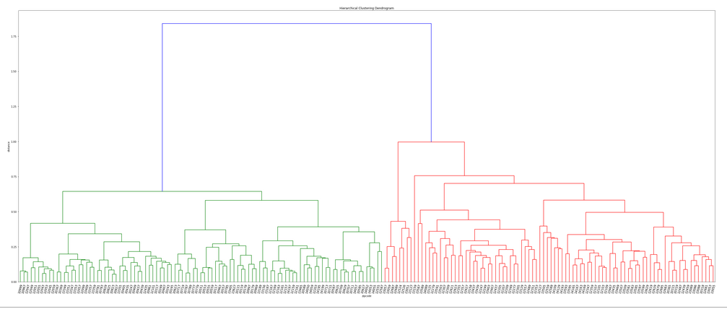
Clusters of zipcodes
Dendrogram shows the distances of zipcodes
Set number of clusters to seven

Slide 8
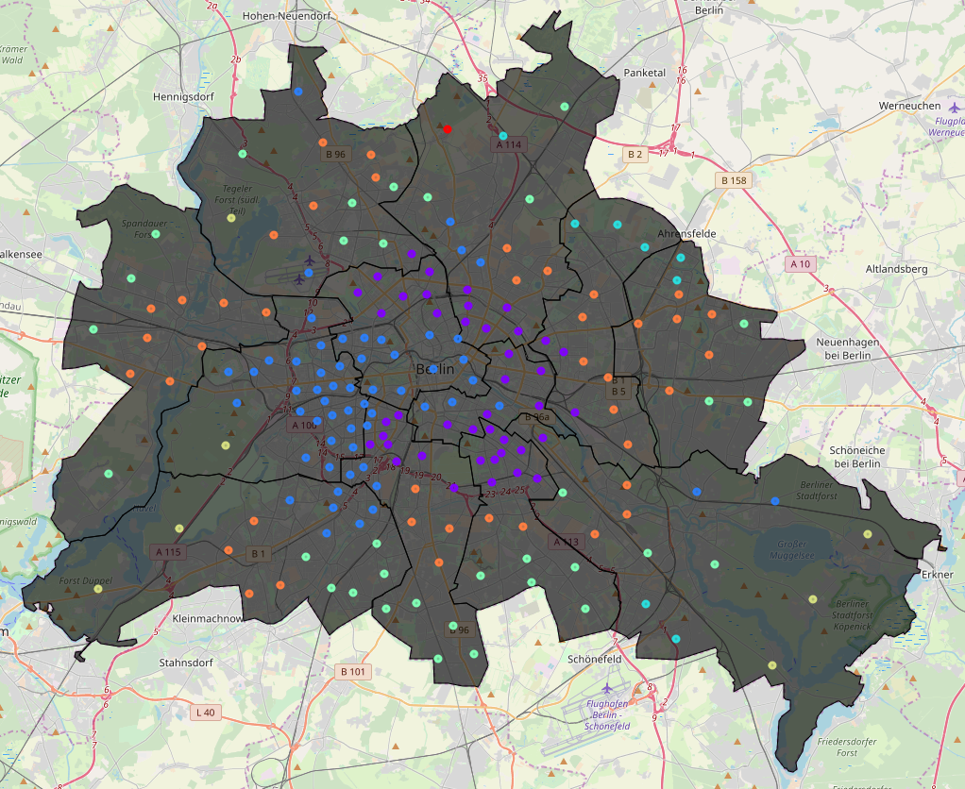
Seven Clusters in Berlin

Slide 9
Attributes of the clusters
Locations
Modes of venue categories: (aggregated per cluster)
Cluster | Location | Cluster | Location
Cluster1 (purple) | center of Berlin (east) | Cluster5 (dark yellow) | south and east
Cluster2 (blue) | center of Berlin (west) | Cluster6 (orange) | around the center, southwest
Cluster3 (cyan) | southwest | Cluster7 (red) | north
Cluster4 (bright green) | around the center: west, south, east
Cluster | Typical venue | Cluster | Typical venue
Cluster1 | Café, Hotel, Bar | Cluster4 | Supermarket, Soccer Field
Cluster2 | Café, Hotel, Park | Cluster5 | Bakery, Cafe, Drugstore
Cluster3 | Bakery, Café, various Restaurants, Supermarket | Cluster6 | Supermarket, Light Rail Station

Slide 10
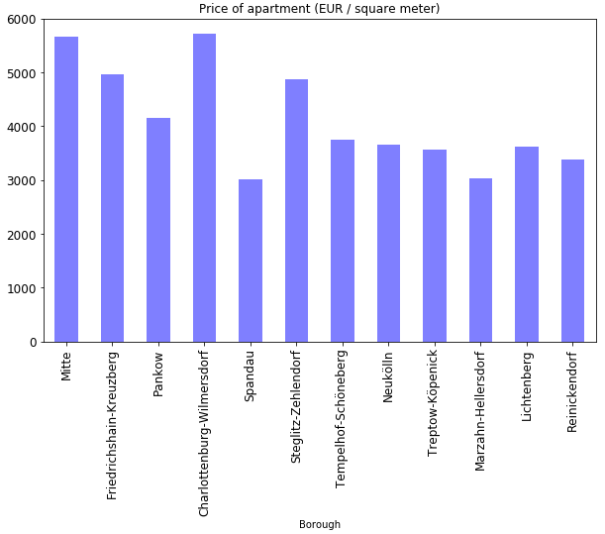
Feature price of apartments

Slide 11
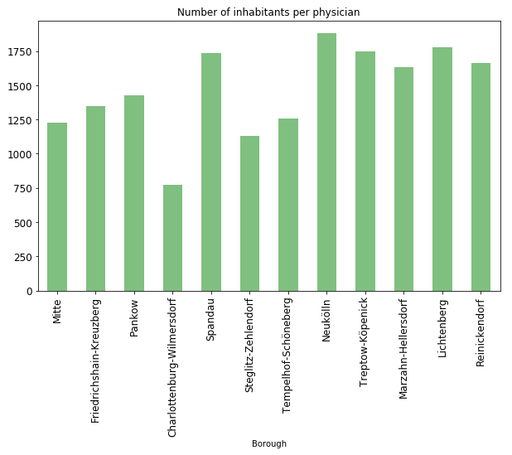
Feature number of physicians

Slide 12
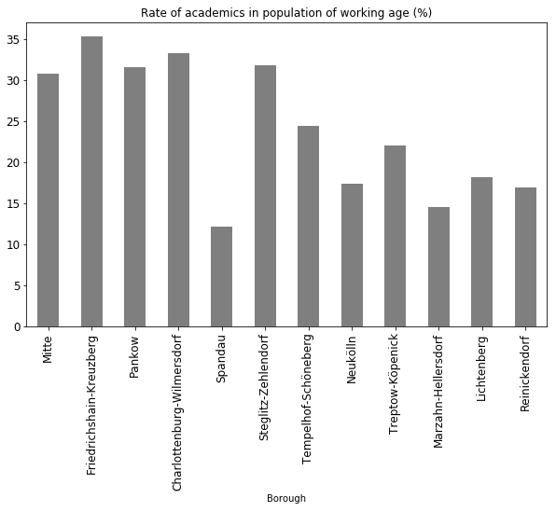
Feature rate of academics

Slide 13
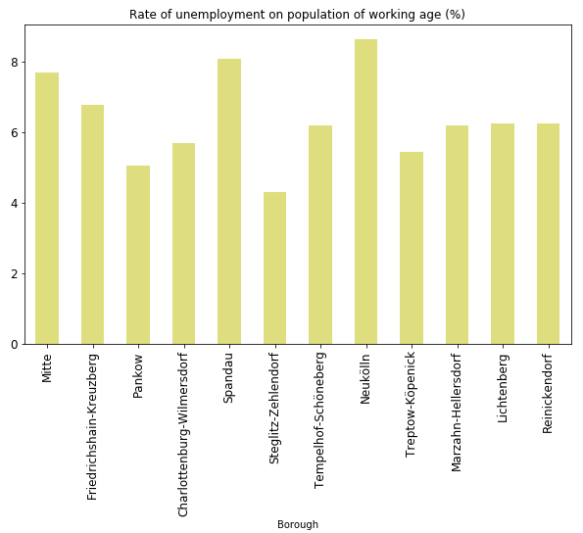
Feature rate of unemployment

Slide 14
Comparison between neighborhoods
Charlottenbourg-Wilmersdorf (CW) and Spandau (SP)
CW has less unemployment, more physicians, more academics, higher apartment prices
Venues structure of both boroughs differ:
CW mainly lies in cluster3, some zipcodes in cluster1, cluster2 and cluster6
SP mainly lies in cluster6, some zipcodes are in cluster4

Slide 15
Thank you

